Slide 1


Look, Read and Enrich Learning from Scientific Figures and their Captions
Jose Manuel Gomez-Perez, Raul Ortega
K-CAP 2019 – Marina del Rey Nov. 20th, 2019

Slide 2
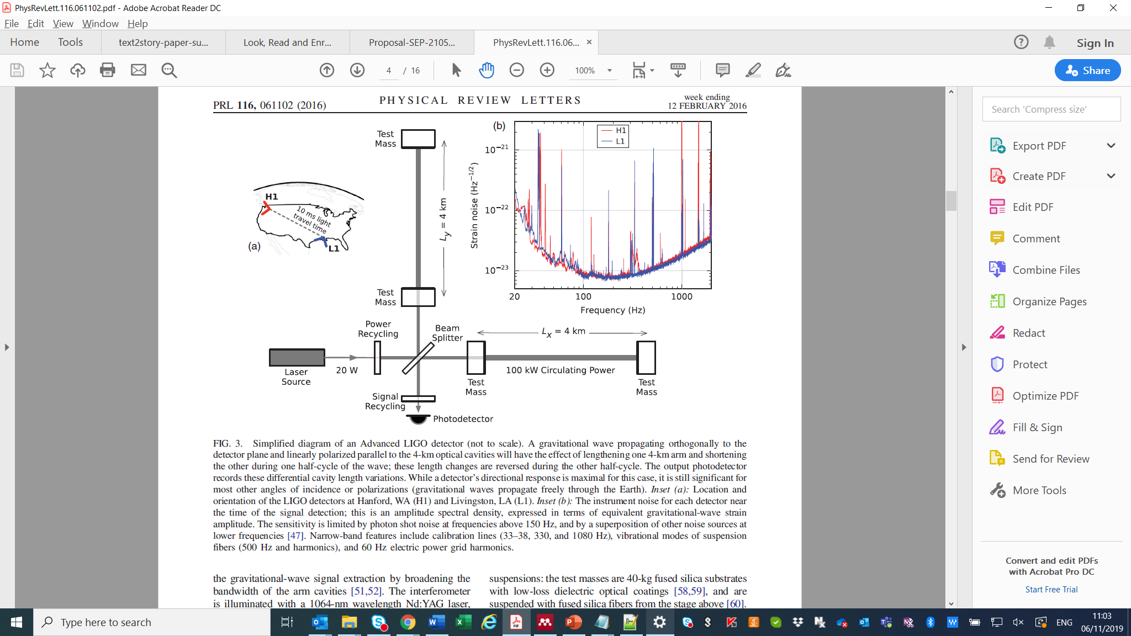
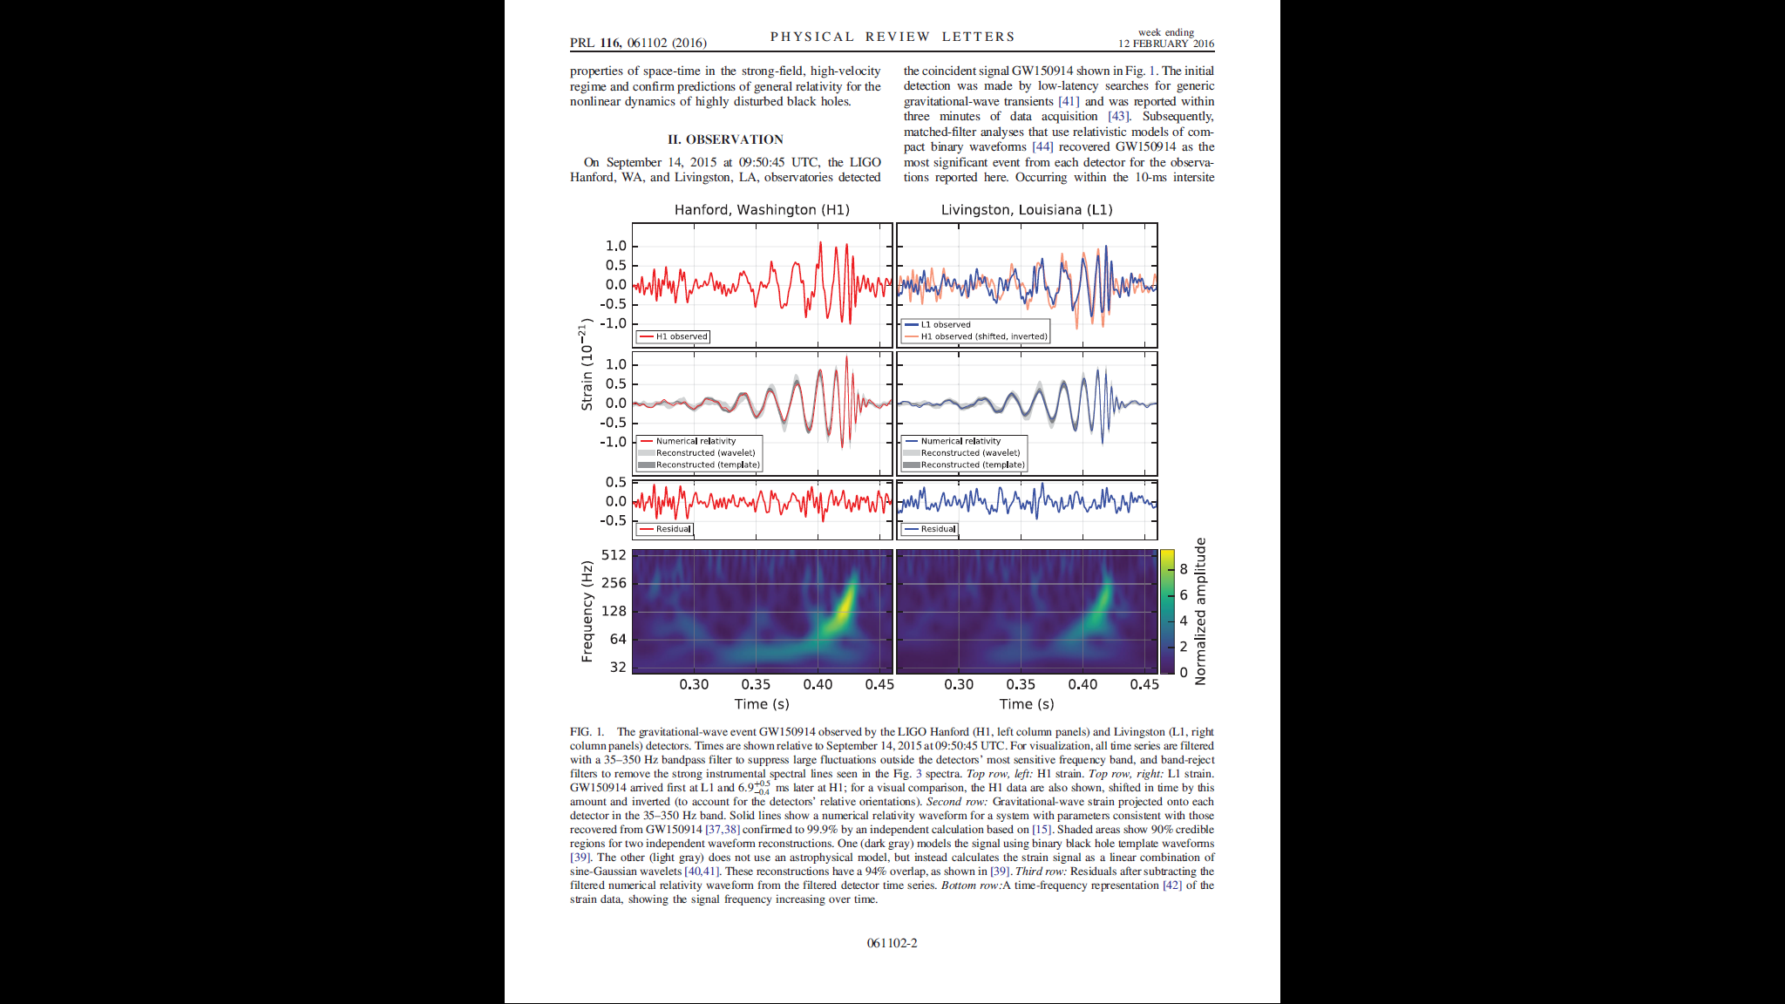
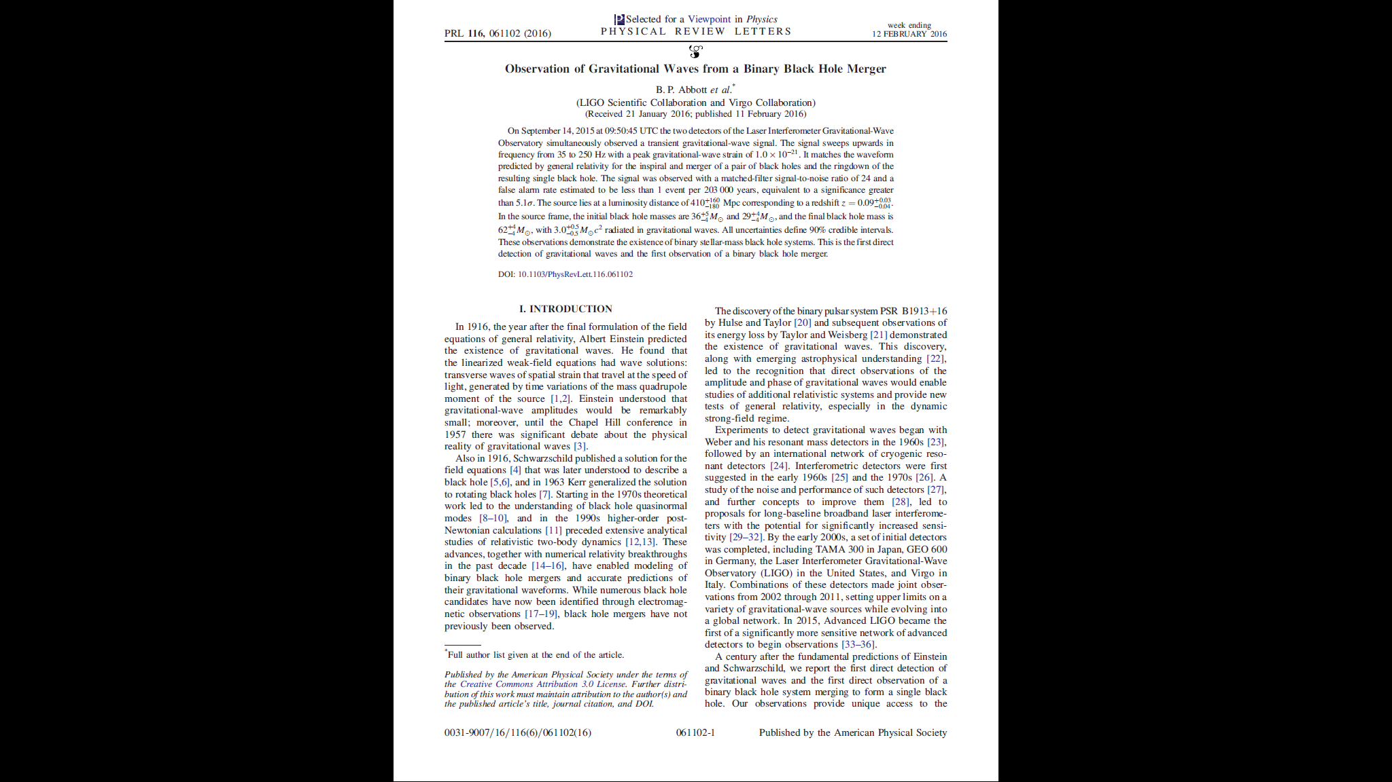
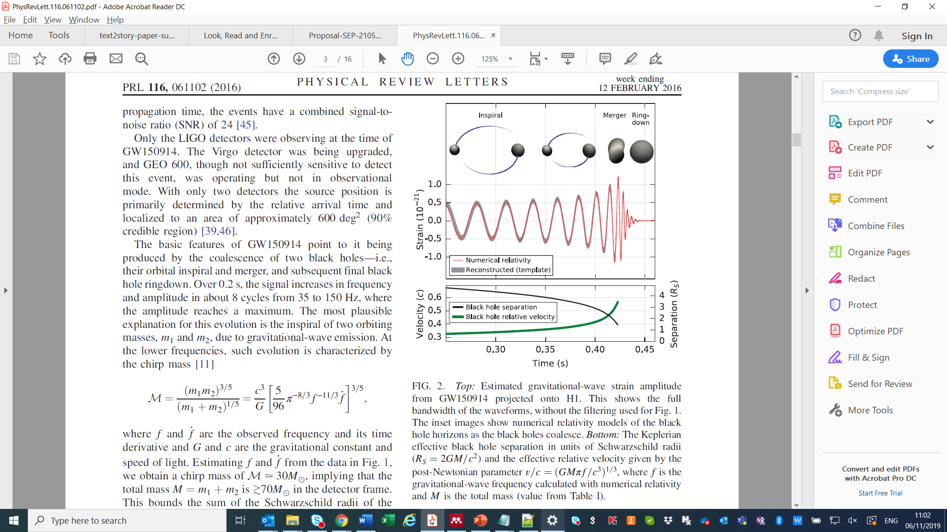
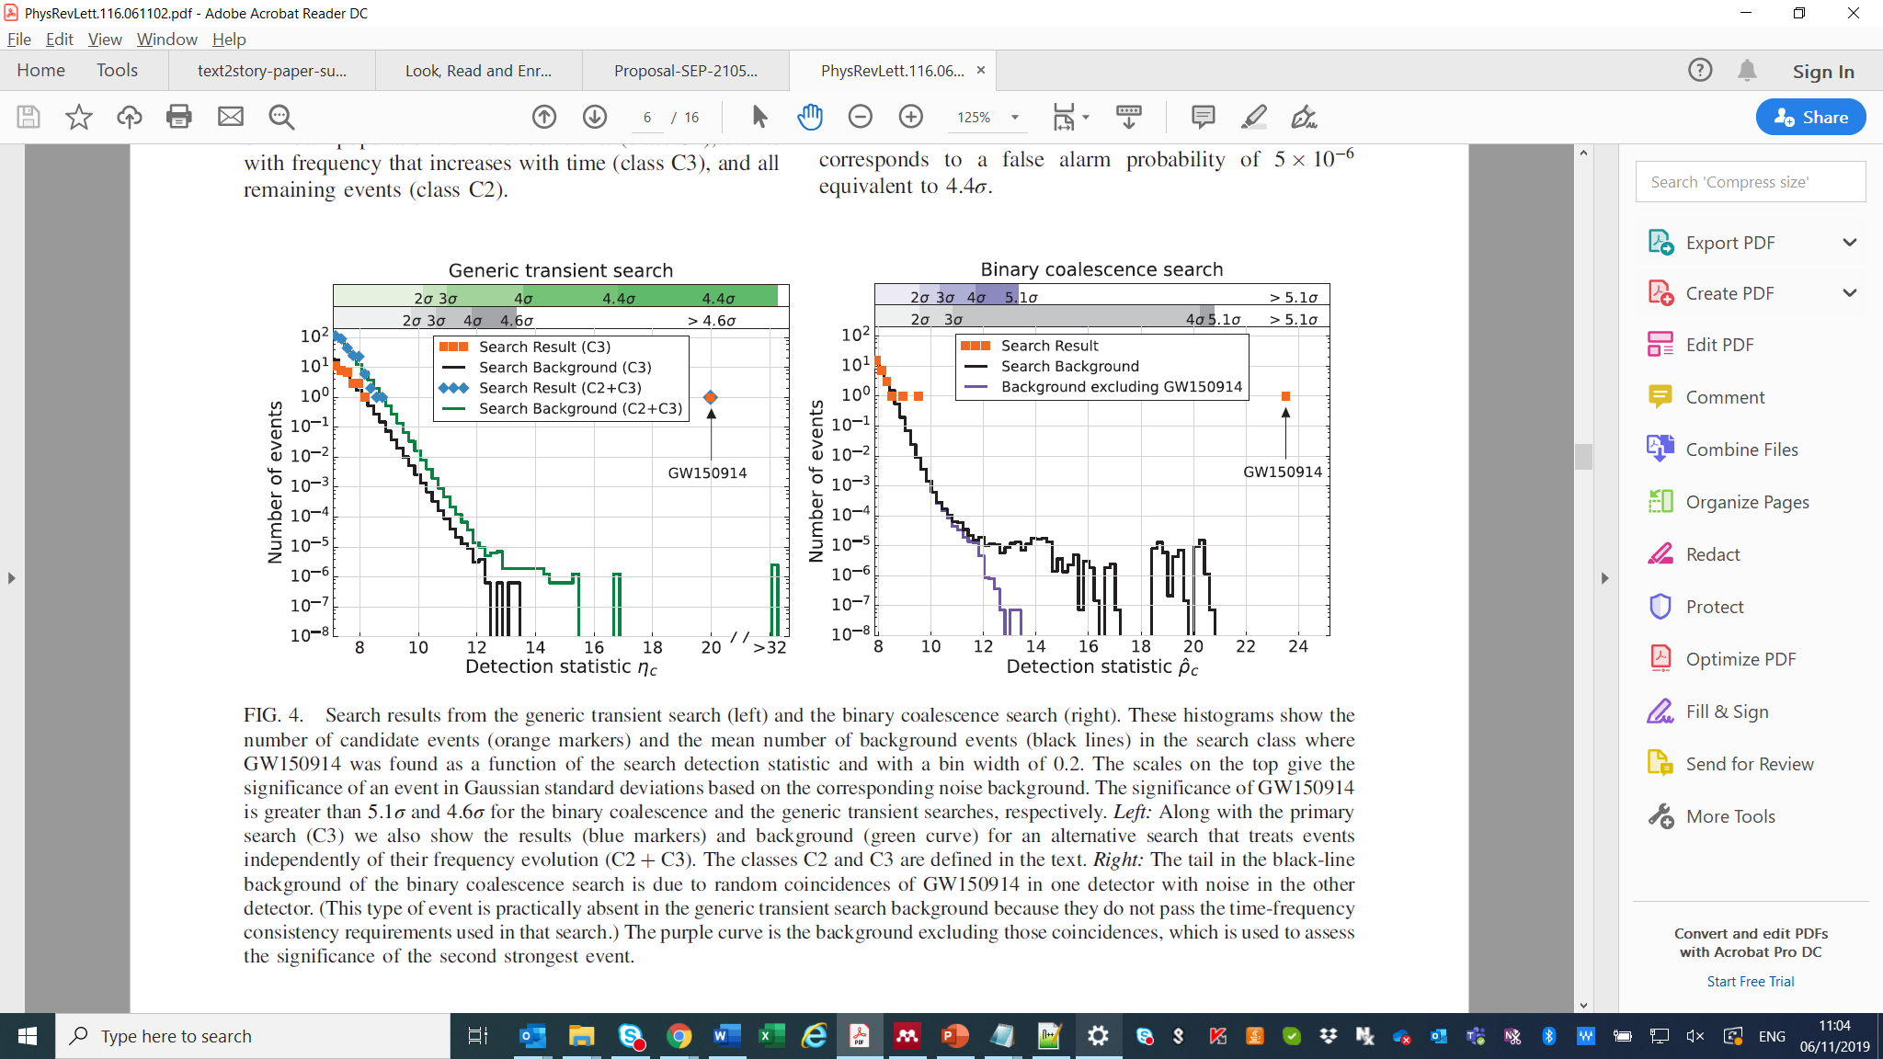
Reading a scientific paper
Like other manifestations of human thought, the scientific discourse usually adopts the form of a narrative, i.e. a scientific publication
However, we rarely read a whole paper sequentially. We may start with the abstract, then check figures and tables to have a glimpse on the methods and experimental results, and iterate until we get a good enough overall understanding
Scientific knowledge is represented in mutually supportive ways across different modalities to facilitate human understanding, including text but also figures and tables
This entails understanding text, but also figures and others, e.g. tables, in the shared context provided by the paper
[Abbott et al., 2017] Observation of Gravitational Waves from a Binary Black Hole Merger
Notes:
Google Scholar reveals its most influential papers for 2019
https://www.natureindex.com/news-blog/google-scholar-reveals-most-influential-papers-research-citations-twenty-nineteen
7) Physical Review Letters 6,009 citations
This study stands out among the rest in this list as one that gained significant media attention and engagement from the general public, making an impact both inside and outside academia.
Through this paper, a team of physicists from the Advanced Laser Interferometer Gravitational-Wave Observatory (LIGO) described the first direct observation of gravitational waves – a feat that took a century to achieve following Einstein’s prediction of these elusive ripples in space-time.
The study got 2.5 times more citations than the second most-cited paper in Physical Review Letters, also from LIGO, which in 2017 announced the first direct observation of a merger between two neutron stars.

Slide 3
Dealing with scientific figures is hard
However, captions give us a lot of supporting evidence!
Definition
What are we looking at?
Description
What is the experiment setup?
Nested knowledge
What else do I need to know to understand this?
Additional information
What is that about?
Notes:
Looking into scientific figures… and their captions
Dealing with scientific figures is very complicated. One needs specific parsers to extract all the different visual components and their connectors and then semantically interpret them and their interconnection
However, there is a lot of supporting evidence in the text of the captions

Slide 4
Figure-Caption Correspondence (FCC)
Look
How can we tap on this source of free supervision?
How can the features learnt by training a FCC task impact on scientific multi-modal machine comprehension?
Fusion
Correspond?
Yes / No
Read
The goal of the FCC task is to capture the correspondence between a figure and a caption
Notes:
.

Slide 5
FCC model and architecture
softmax 2
fc1 128x2 2
fc1 1024x128 128
concat 1024
Vision subnetwork
pool1 2x2 112x112x64
conv1_2 3x3x64 224x224x64
conv1_1 3x3x64 224x224x64
pool2 2x2 56x56x128
conv2_2 3x3x128 112x112x128
conv2_1 3x3x128 112x112x128
pool3 2x2 28x28x256
conv3_2 3x3x256 224x224x64
conv3_1 3x3x64 56x56x256
pool4 28x28 1x1x512
conv4_2 3x3x512 28x28x512
conv4_1 3x3x512 28x28x512
Fusion subnetwork
224x224x3
FCC is a binary classification task
2-branch neural architecture with three subnetworks (vision, language, fusion) and 32M trainable parameters
FCC learns text and visual features from scratch in a totally unsupervised manner
Back-propagation transfers information from the language to the visual model and vice versa
pool1 5 199x512
conv1 5x512 996x512
pool2 5 39x512
conv2 5x512 195x512
pool3 35 1x512
conv3 5x512 35x512
1000x300
Language subnetwork

Slide 6
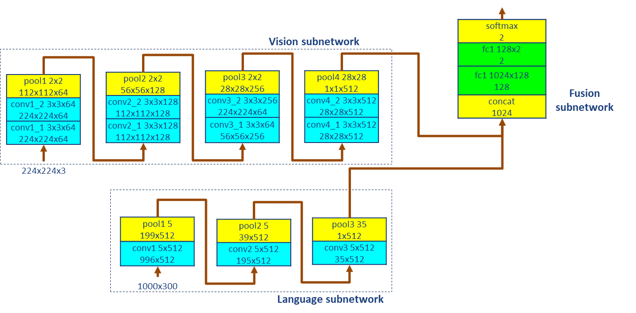
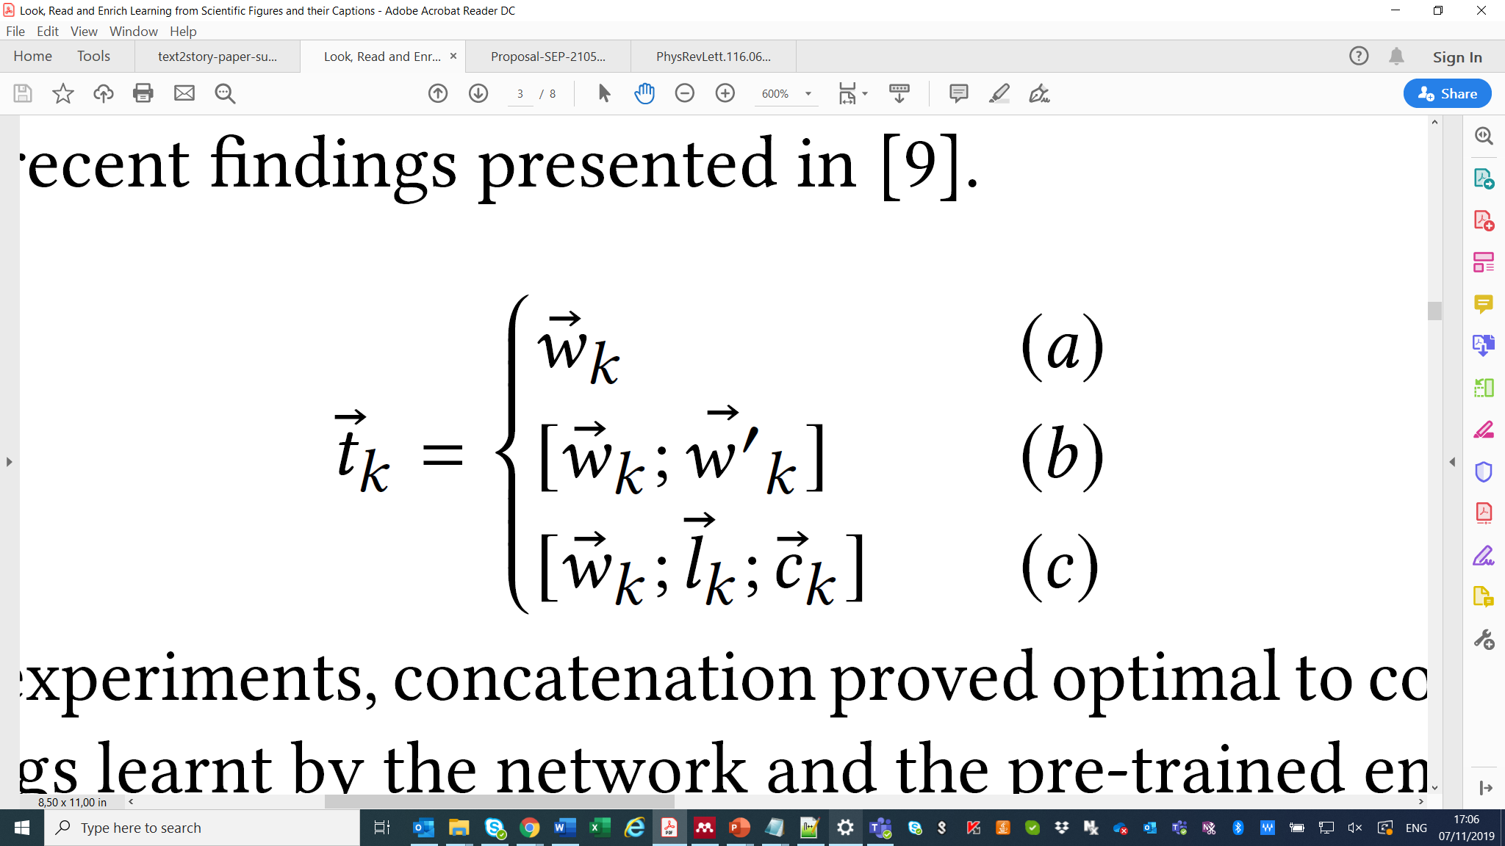
Look, Read… and Enrich
Word: “making”
Lemma: “make”
Concept (meaning): “Create or produce something”
Word embeddings learnt by the network
Learnt and pre-trained word embeddings (FastText)
Learnt word embeddings and pre-trained semantic embeddings (HolE, Vecsigrafo)
= Input word d-D embedding, D=300

Slide 7
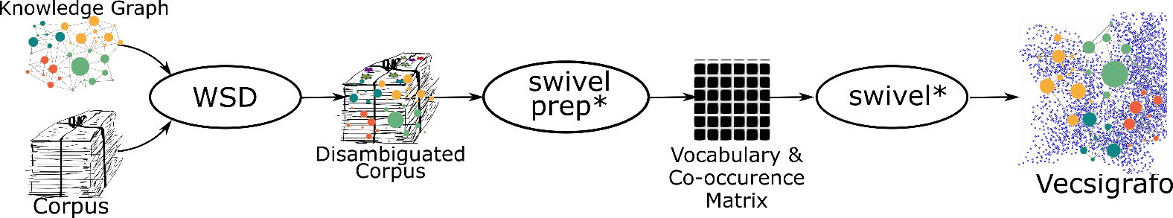

Vecsigrafo
Vecsigrafo jointly learns word and concept embeddings
Combines corpus-based and graph-based approaches
Extends Swivel algorithm to consider both lexical and semantic entries as part of the vocabulary
The corpus is lemmatized following different tokenization strategies, disambiguated and expanded
Word and semantic (lemma and concept from the KG) embeddings are then jointly learnt
In FCC we use Sensigrafo, the Cogito KG, with ~300K concepts, ~400K lemmas and 80+ relation types (~2.8 million links) per language (14)
Vecsigrafo: Corpus-based Word-Concept Embeddings

Slide 8
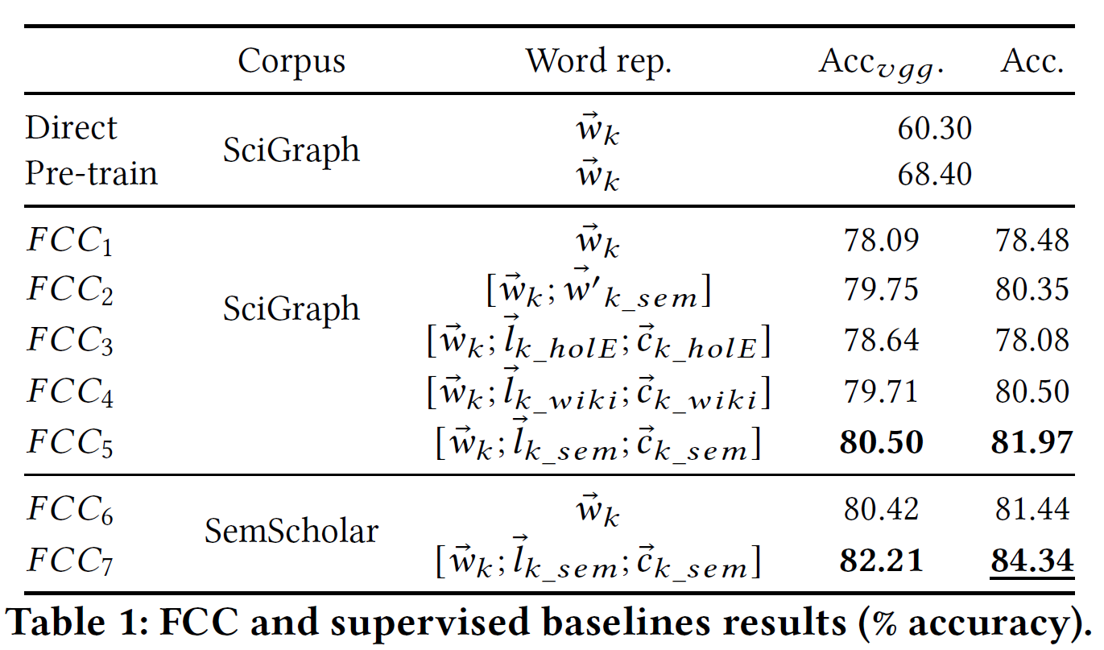



FCC - Evaluation
Two supervised baselines. First, train visual and text networks in a SciGraph classification task
Direct combination: Calculate softmax similarity between the output of both networks
Supervised pre-training: Freeze feature extraction trunks and train FCC on fully connected layers
All variations of FCC improve over the baselines
Results using pre-trained VGG16 visual features suggest the visual information contained in scientific figures differs from natural images
Enrichment and corpus size help
Semantic enrichment with Vecsigrafo improved over HolE, suggesting limited KG coverage
Domain specificity over sheer corpus size for Vecsigrafo training (Semantic Scholar vs. Wikipedia)
7M publications
39M papers
Notes:
Direct combination focuses on the level of agreement between the models of each modality, while supervised pre-training is the conceptually closest supervised model to our approach

Slide 9
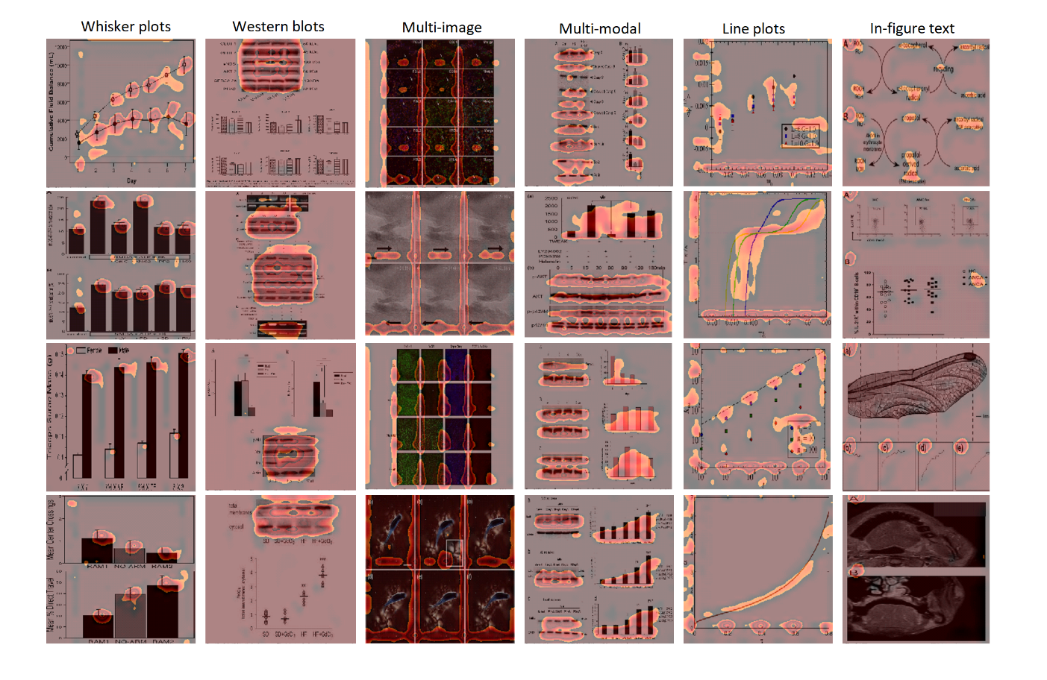
Qualitative analysis – Visual features
Analysis carried out on the (unconstrained) SciGraph dataset
Focus on the 512 features in the last visual convolutional block
Select those with the most significant activation over the dataset
Select the figures that most significantly activate such features
Only figures were used, no text
Distinct visual patterns emerge in each selected feature
Key elements clearly discriminated
Activation and semantic specificity seem to be correlated

Slide 10
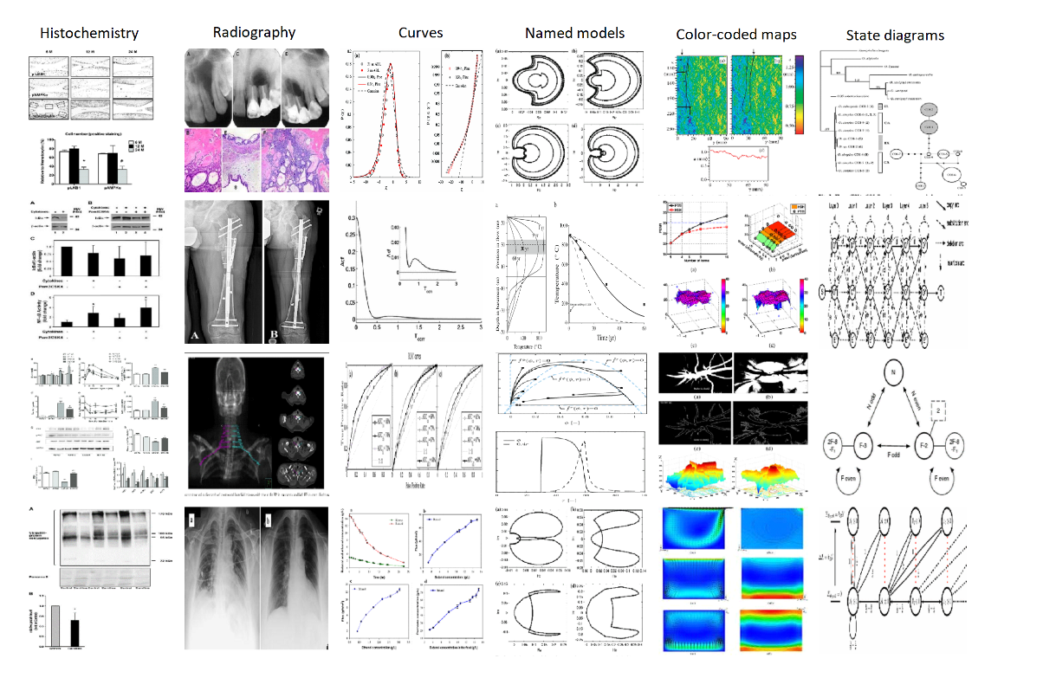
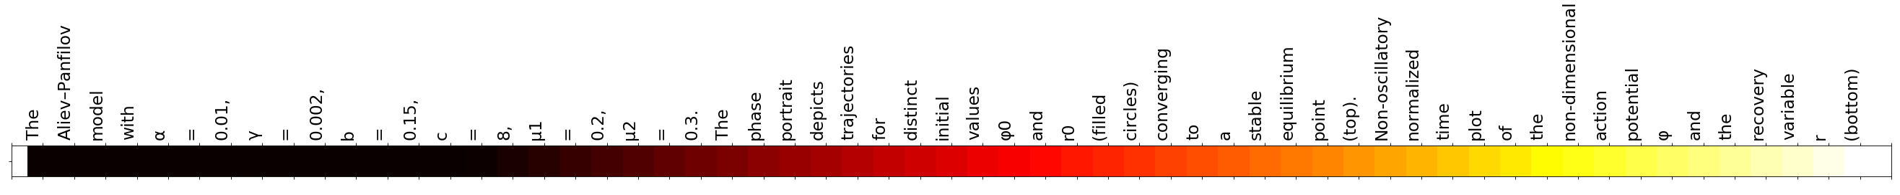
Qualitative analysis – Text features
Similar approach as in the visual case
Focus on text, no figures (only shown for visualization purposes)
Focus on the 512 features in the last text convolutional block
Select those with the most significant activation over the dataset
Select the captions that most significantly activate such features
Textual discrimination is clear, with distinct patterns related to specialized terminology, entities
Also, text similarity, relatedness, is-a (inmunoblot "is-a" type of western blot)

Slide 11
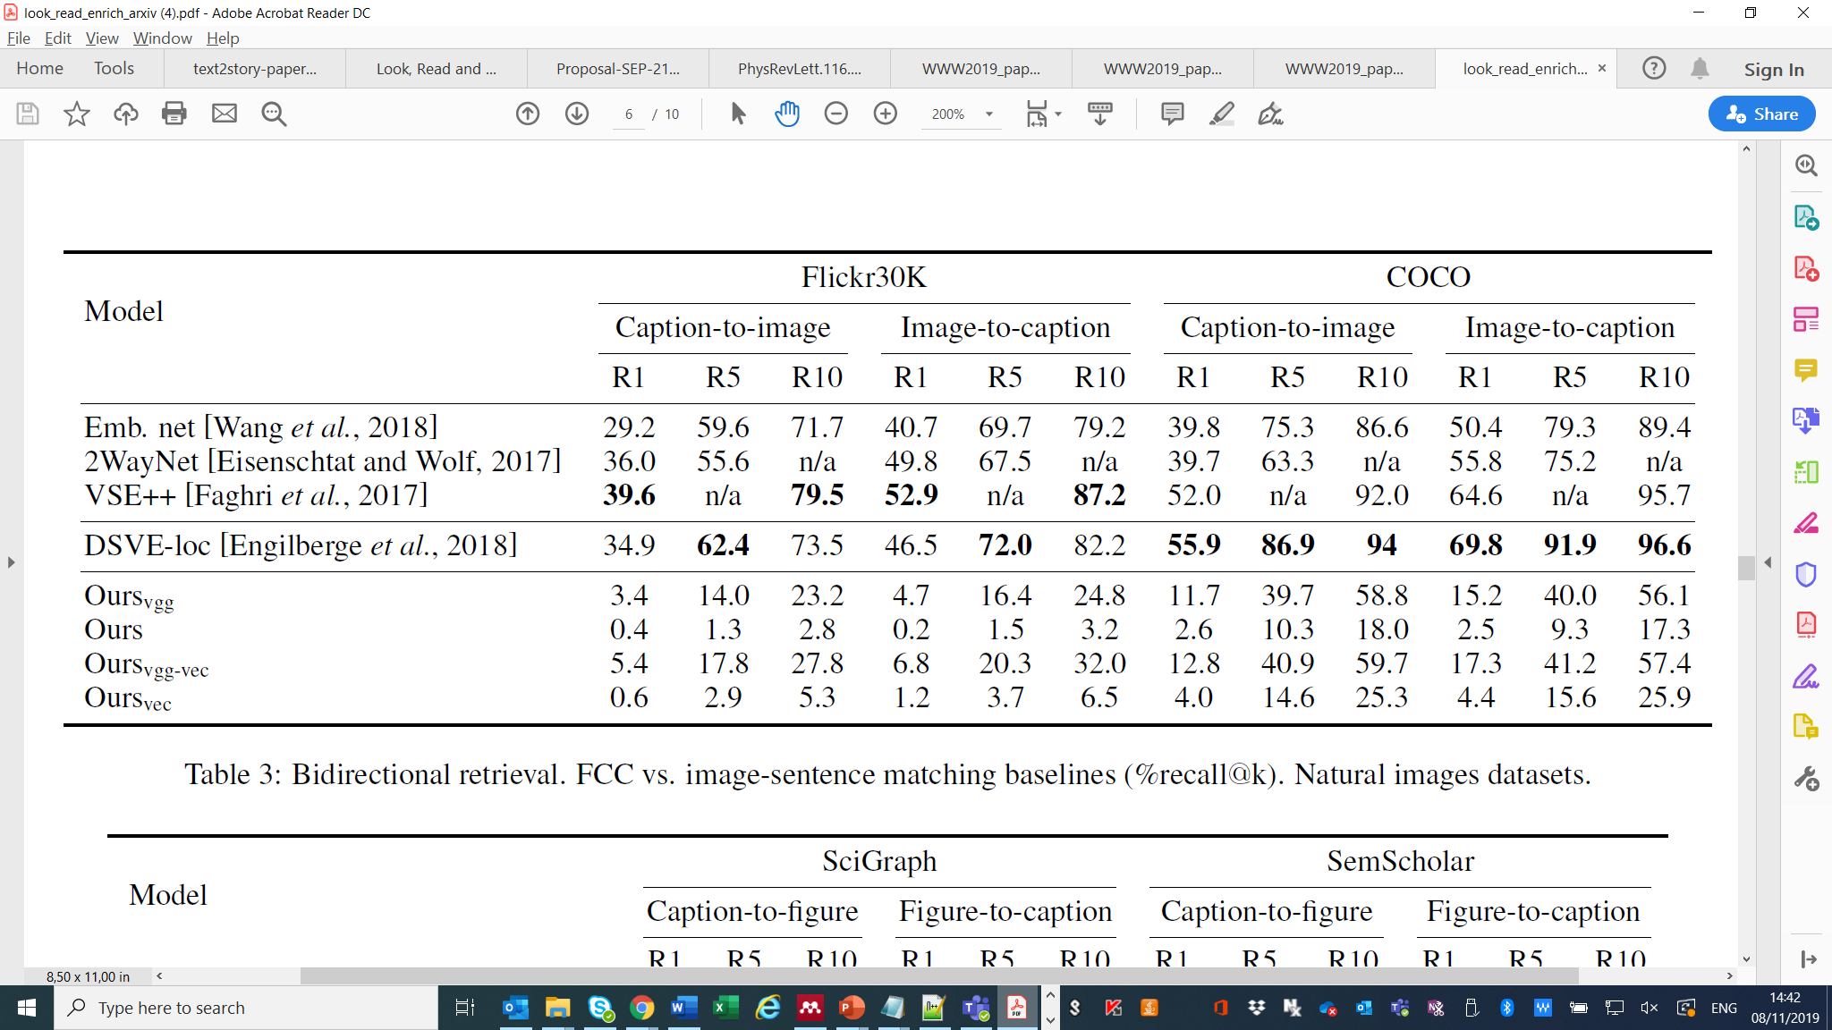
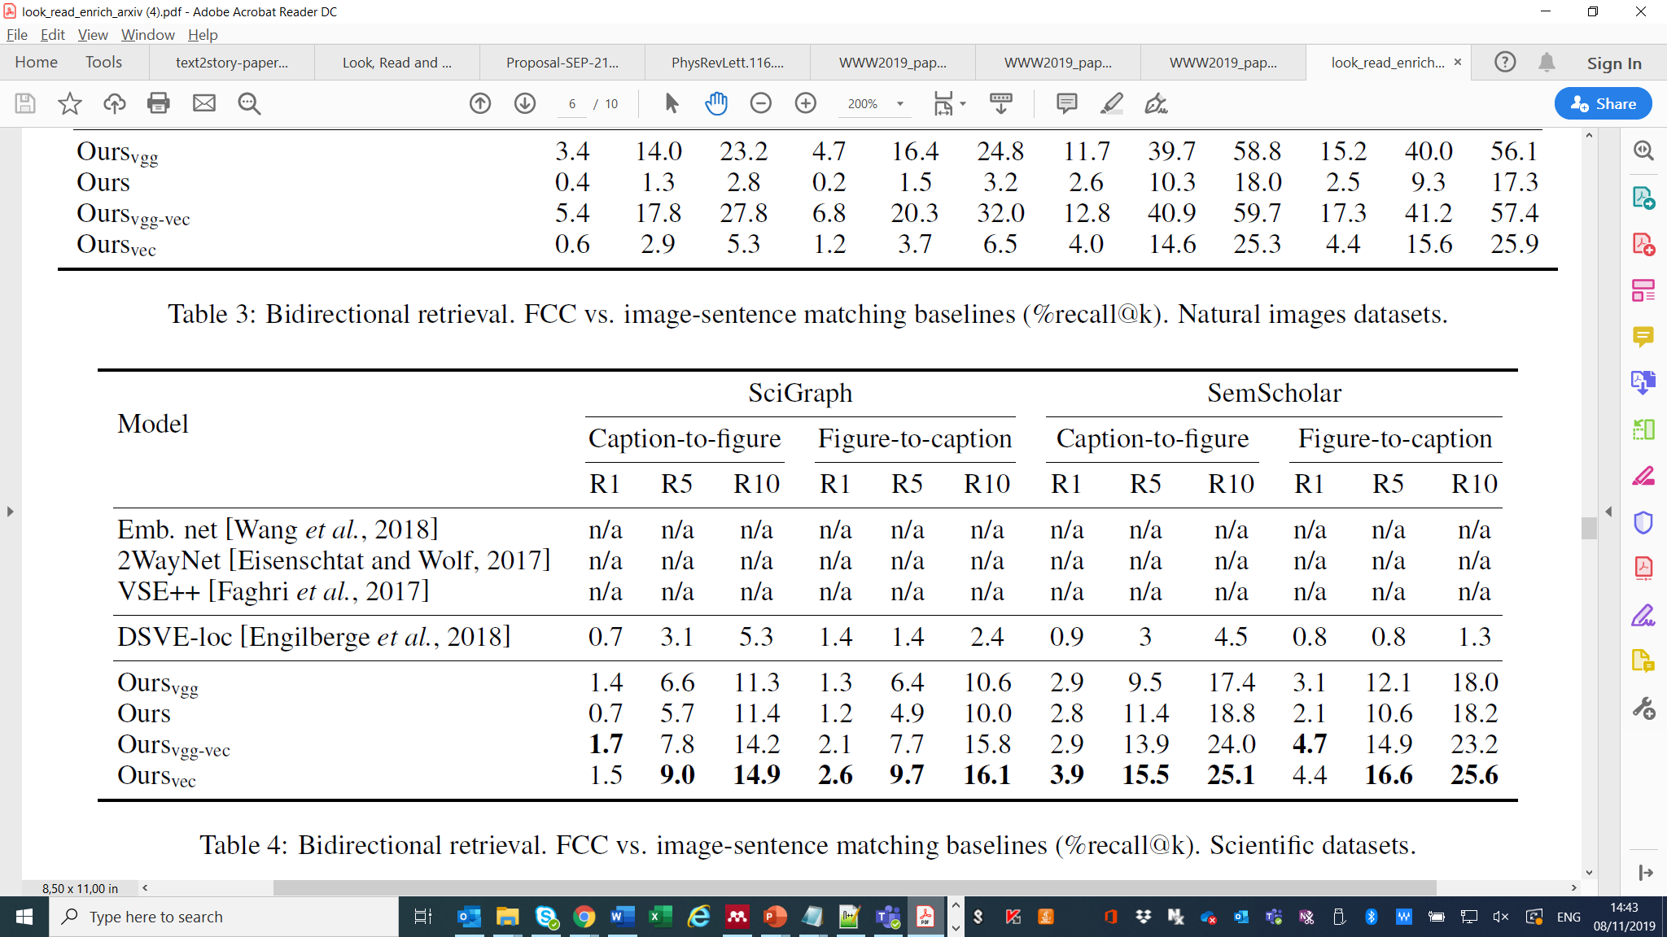
Scientific figures vs. natural images
We trained a bidirectional retrieval task over natural images and scientific datasets, where images are sought given a caption and vice-versa
Results in %recall@k, k={1,5,10}
FCC trained in all datasets and compared against image-sentence matching SoA
Strong divide between the results from the natural and scientific datasets
The best baseline with natural images DSVE-loc performs poorly with scientific figures and captions
This shows evidence that dealing with scientific figures and captions has added complexity
Pre-trained VGG16 features help FCC with natural images
FCC+Vecsigrafo obtains the best results with scientific figures over the board
Natural images
Scientific figures
Notes:
Tasks like image-sentence matching are well covered. However, dealing with scientific figures entails additional challenges
Scientific figures are more abstract, arbitrary and symbolic
Scientific captions are significantly longer, e.g. ~42 words in Semantic Scholar vs. ~11 in COCO
Only one possible caption per figure and vice versa unlike natural image datasets

Slide 12
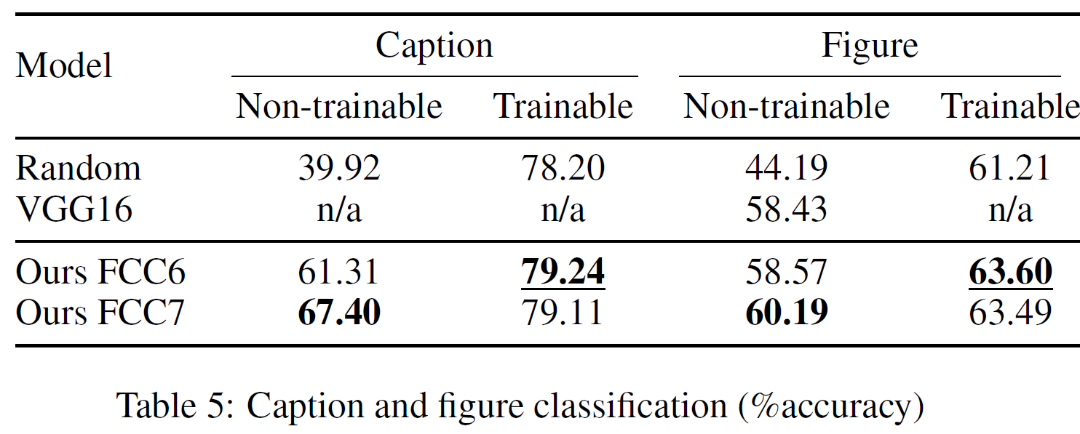
Caption and figure classification
Classification against the SciGraph taxonomy
Reuse FCC text and vision network architectures
Leverage FCC text and vision features
Uni-modal baselines (%accuracy): 78.20 and 61.21 for captions and figures, respectively
Two main experiments
Measure the contribution of the FCC features: Freeze features and fine-tune fully connected and softmax layers only
Calculate an upper bound, by fine-tuning the whole networks
In all cases FCC-based classifiers outperform the unimodal baselines
VGG16 features pre-trained on ImageNet under FCC, suggesting higher complexity of scientific figures
In both captions and figures, semantic enrichment (“Ours FCC7”) makes up for the lack of fine-tuning in the feature trunks

Slide 13

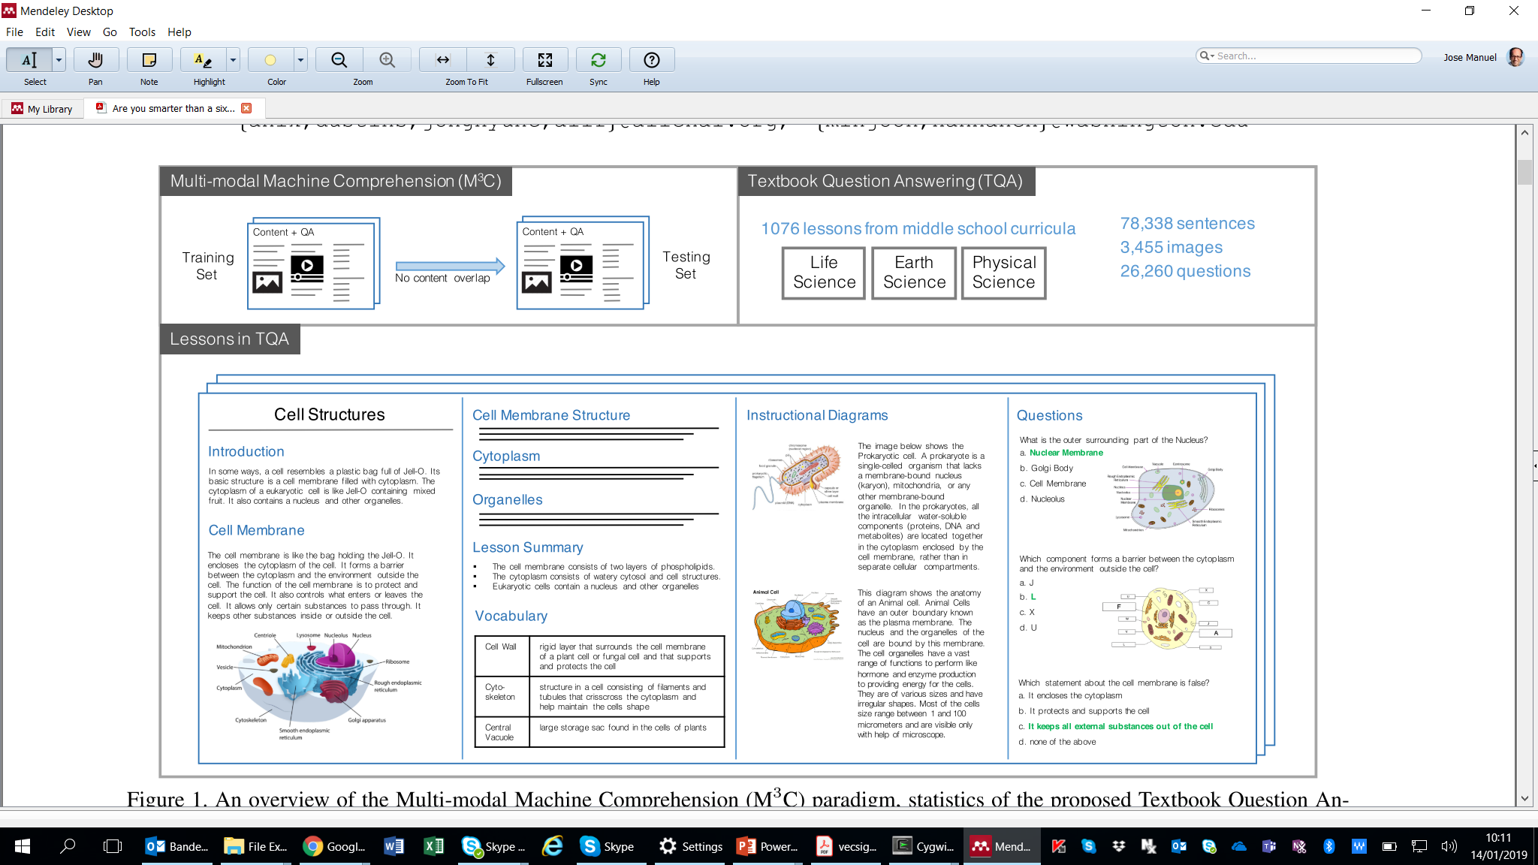
Textbook Question Answering

Slide 14
TQA-FCC model
Attended vector
Similarity (AV-C_{k}) + Softmax
Answer
Attention (P→Q) + Softmax
Paragraph diagram (FCC)
Combination (concatenation)
Combination
(concatenation)
Question diagram (FCC)
Embedding + Encoding (LSTM)
Embedding + Encoding (LSTM)
Embedding + Encoding (LSTM)
Enrichment (Vecsigrafo)
Enrichment (Vecsigrafo)
Enrichment (Vecsigrafo)
5.6M parameters, 2.1M trainable
Paragraph text (TF-IDF selected)
Question text
Candidate text (C_{k})

Slide 15
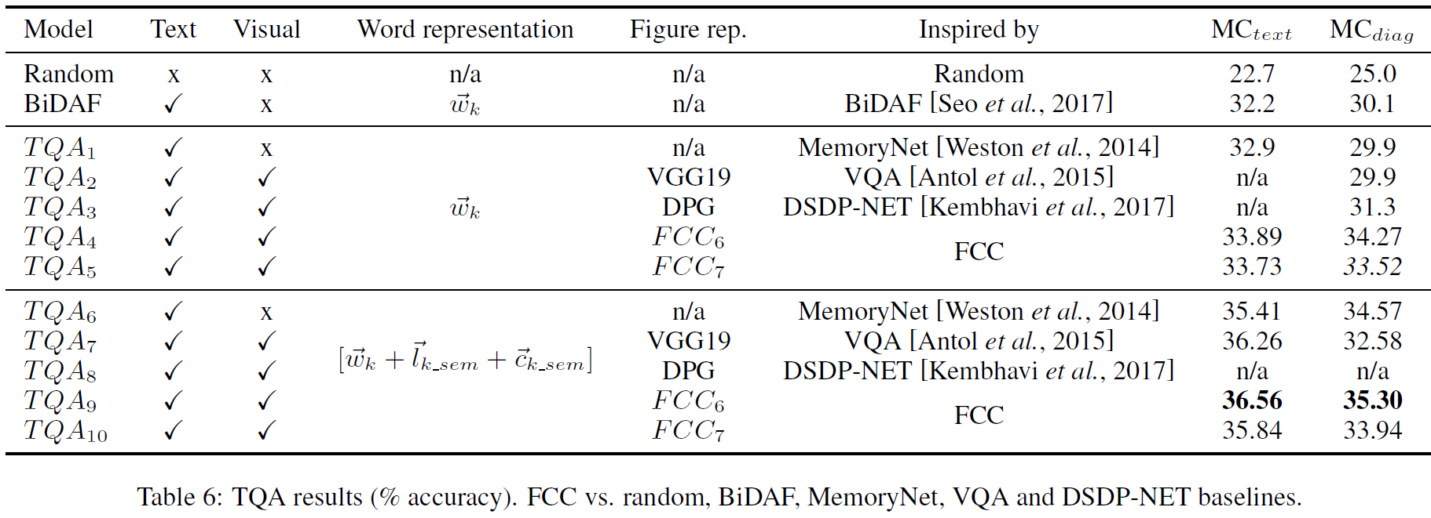
TQA – results
Focus on MC questions (%73)
5 baselines: BiDAF, Memory Net, VQA, DSDP-NET
Some known limitations like long question context and large lexicon addressed:
Leverage the whole book, not just the lesson of the question
Pareto used to fix maximum token sequence length
No additional optimization like semantic expansion or sentence embeddings used
40.21 as of Nov. 15th!
Using FCC features (TQA4-5 TQA9-10) beats all TQA baselines in diagram MC
Also in text MC, through Vecsigrafo-enriched word representations of the TQA corpus (TQA6-10)

Slide 16
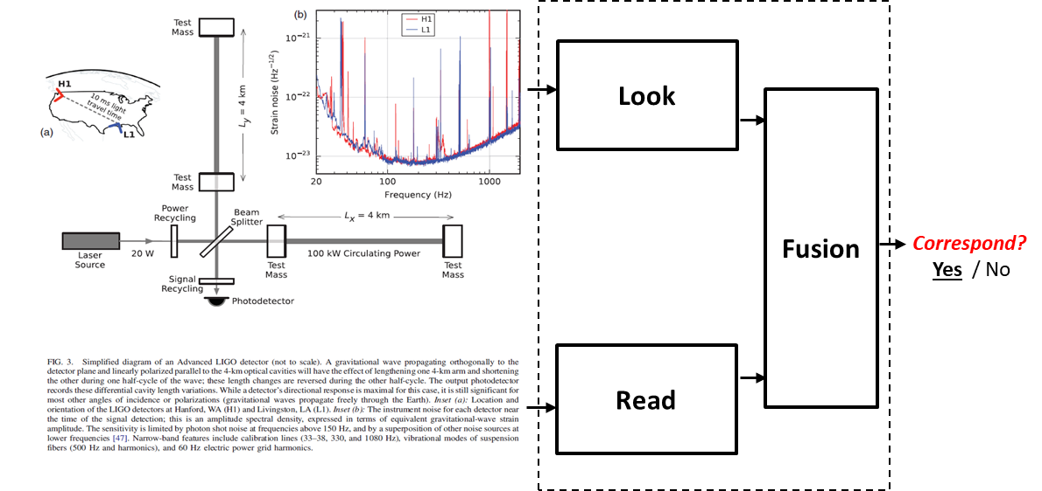
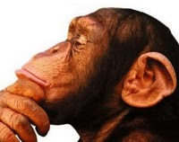
Conclusions and future work
Learning from the correspondence between scientific figures and captions helps propagate information across modalities, improving MRC in the scientific domain
Next steps include
NLMs e.g. (Sci)Bert to encode scientific text
Finer-grain analysis of figure components and their correlation with (parts of) captions
Experiment with FCC visual features in diagram parsing architectures like DSDP-NET [Kembhavi et al., 2017]
Pass the TQA exam! Cover True/False questions through RTE, smarter strategies to select relevant paragraphs

Slide 17
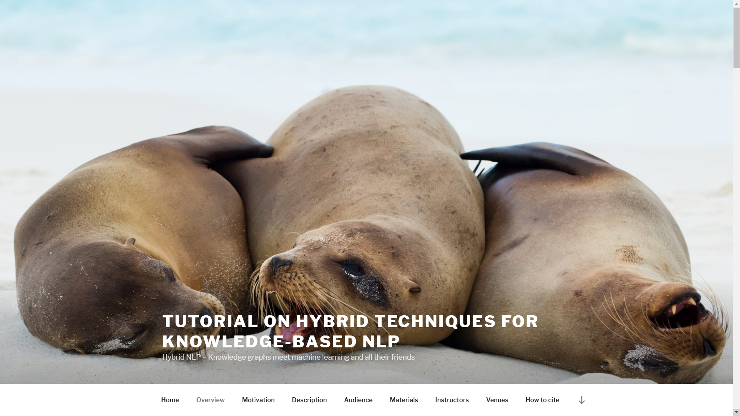
http://hybridnlp.expertsystemlab.com/tutorial

Slide 18
Look, Read and Enrich Learning from Scientific Figures and their Captions
Jose Manuel Gomez-Perez, R&D Director
jmgomez@expertsystem.com

